Slide 1
Lecture 1 Introduction
Ran Cheng (程然)
https://chengran.tech/
https://emi.sustech.edu.cn/

Slide 2
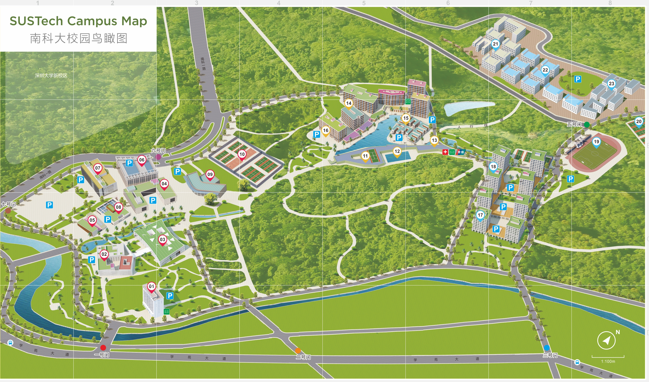


Real-world problems

Slide 3
Problem Solving
Example: a sorting problem
Sort a set of cards
Sort the student list according to scores
How would a human solve a problem?
Uses brain, hands
How would a computer solve a problem?
Uses CPU, memory
A series of operations: algorithms & data structures

Slide 4
Algorithm

Slide 5
What is an algorithm?
Algorithm: a well defined sequence of steps for solving a computational problem
It produces the correct output
It uses basic steps / defined operations
It finishes in finite time
Idea of a selection sort method
Start with empty hand, all cards on table
Pick the smallest card from table
Insert the card into the hand

Slide 6
Sorting algorithm
Example: selection sort algorithm
Input: an array A of n numbers
Output : an array A of n numbers in the ascending order
Selection-Sort ( A[1..n] )
1. for integer i ← 1 to n–1
2. k ← i
3. for integer j ← i+1 to n
4. if A[k] > A[j] then
5. k ← j
6. swap A[i] and A[k]
5 | 2 | 4 | 9 | 7
2 | 5 | 4 | 9 | 7
unsorted
2 | 4 | 5 | 9 | 7
unsorted

Slide 7
How algorithm solves a problem?
Real-world input
Problem definition
Input
Design algorithm
Program
Algorithm implementation
Output
Real-world output

Slide 8
Data structure
Algorithms depend on data structures

Slide 9


What is data structure?
set
Let S be a set of items, and x be a search key
A key is a number, e.g., product id
Useful operations on a set S
Search(S, x): search whether x appears in S
Insert(S, x): insert item x into S
Delete(S, x): remove item x from S
Data structure:
A way of organizing data objects for efficient usage
Building blocks for designing algorithms
3
8
7
2
search key
5

Slide 10
Why data structure?
You will learn them in this course …
Why so many data structures?
They support different operations, and with different time complexities
Which data structure is better?
Depends on the frequency of operations used in your algorithm
E.g., it is fast for the most frequent operation in your algorithm
Array
Linked List
Stack
Queue
Hash table
Heap
Tree
……

Slide 11
DSAA Demo
Find our classroom

Slide 12

Any idea?

Slide 13
(x₀, y₀)
Y
(x₂₁, y₂₁)
21
(x₂₂, y₂₂)
22
(x₂₃, y₂₃)
(x₁₃, y₁₃)
(x₁₄, y₁₄)
23
(x₁₂, y₁₂)
14
(x₁₆, y₁₆)
(x₇, y₇)
(x₁₀, y₁₀)
15
20
16
13
(x₂₀, y₂₀)
10
12
19
(x₆, y₆)
6
11
(x₁₈, y₁₈)
(x₁₉, y₁₉)
7
9
(x₉, y₉)
(x₁₁, y₁₁)
(x₁₅, y₁₅)
18
4
(x₈, y₈)
8
(x₅, y₅)
17
(x₁₇, y₁₇)
(x₄, y₄)
5
3
(x₂, y₂)
2
(x₃, y₃)
1
(x₁, y₁)
X

Slide 14
Y
if(xi==x0 && yi==y0)
“It is our classroom”
else
“It is not our classroom”
x₂₁== x₀ && y₂₁ == y₀
21
14
15
20
16
13
10
12
19
7
6
11
18
4
9
8
17
5
2
3
1
X

Slide 16
Left
Right
L0
L1
L2
R0
R1
R2
01,02,03
04,05,06,07,08
09,10
11,12,13,14,15,16
17,18
19,20,21,22,23

Slide 17
Tree data structure
Let S contain all tree nodes, and x denote our classroom
Useful operations on a set S
Children(S): find the children of S
Search(S, x): search whether x appears in S
Tree data structure:
A way of organizing data objects for efficient usage
Useful operations for designing algorithms

Slide 18
Algorithm Designs

Slide 19


Algorithm design techniques
Incremental technique
Build a solution into a larger solution
E.g., we have a sorted subarray A[1..i–1], then append an item to obtain a sorted subarray A[1..i]
Recursive technique (or divide-and-conquer)
Reduce the problem into smaller subproblems
E.g., find the smallest item in subarray A[i..n], then sort the subarray A[i+1..n]

Slide 20

Example: number guessing game
Rules
Host: pick a secret integer X from 1 to 20
Guest: guess V as the answer
→ Host: “V is too low” / “V is too high” / “V is correct!”
Simple strategy: test each integer in ascending order
Guess 1 → too low
Guess 2 → too low
……
Guess 19→ correct!
Can you suggest a more efficient strategy?
pick X=19

Slide 21
Divide-and-conquer Strategy
Guess the number game
Guess 10 → too low
[Think] Is X between 1 and 9? NO
[Think] Is X between 11 and 20? YES
Guess 15 → too low
[Think] Is X between 11 and 14? NO
[Think] Is X between 16 and 20? YES
Guess 18→ too low
Guess 19→ correct!
1 - 9
10
11 - 20
11 - 14
15
16 - 20

Slide 22
Recursive Technique

Slide 23
Iteration
When we encounter a problem that requires repetition, we often use iteration – i.e., some type of loop
Sample problem: printing the series of integers from n1 to n2, where n1 <= n2.
printSeries(1,8) should print the following
1, 2, 3, 4, 5, 6, 7, 8
Iterative solution:
public static void printSeries(int n1, int n2){
for(int i=n1; i<n2; i++)
System.out.print(i + ”, ”);
System.out.println(n2);
}

Slide 24
Recursion
An alternative approach to problems that require repetition is to solve them using recursion
A recursive method is a method that calls itself
Applying this approach to the printSeries problem:
public static void printSeries(int n1, int n2){
if(n1 == n2){
System.out.println(n2);
} else {
System.out.print(n1 + ”, ”);
printSeries(n1 + 1, n2);
}
}

Slide 25
What happens with recursion?
When we execute printSeries(1,3):
System.out.print(1 + ”, ”); // 1,
printSeries(2,3):
System.out.print(2 + ”, ”); // 1, 2,
printSeries(3,3):
System.out.println(3); // 1, 2, 3 \n
return
return
return

Slide 26
Recursive problem-solving
When we use recursion, we solve a problem by reducing it to a simpler problem of the same kind
We keep doing this until we reach a problem that is simple enough to be solved directly.
The simplest problem is known as the base case
public static void printSeries(int n1, int n2){
if(n1 == n2){ // base case
System.out.println(n2);
} else {
System.out.print(n1 + ”, ”);
printSeries(n1 + 1, n2);
}
}
The base case stops the recursion, because it does not make another call to the method

Slide 27
Recursive problem-solving
If the base case has not been reached, we execute the recursive case
public static void printSeries(int n1, int n2){
if(n1 == n2){ // base case
System.out.println(n2);
} else { // recursive case
System.out.print(n1 + ”, ”);
printSeries(n1 + 1, n2);
}
}
The recursive case:
Reduces the overall problem to one or more simpler problems of the same kind
Makes recursive calls to solve the simpler problems.

Slide 28
Template of recursive method
RecursiveMethod (parameters){
if (stopping condition){
// handle the base case
} else {
// recursive case
// possibly do something here
RecursiveMethod (iteratively modifed parameters);
// possibly do something here
}
}
There can be multiple base cases and recursive cases
When we make the recursive call, we typically use parameters that bring us closer to a base case

Slide 29
Example: printing a file to the console
Here is a method that prints a file using iteration
public static void printFile (Scanner input){
while(input.hasNextLine()){
System.out.println(input.nextLine());
}
}
Here is a method that uses recursion to do the same thing:
public static void printFileRecursive (Scanner input){
if(!input.hasNextLine()){ // base case
return;
} else { // recursive case
System.out.println(input.nextLine());
printFileRecursive(input); // print the rest
}
}

Slide 30
Example: printing a file in reverse order
What if we want to print the lines of a file in reverse order?
It is not easy to do this using iteration. Why?
It is easy to do it using recursion!
How could we modify our pervious method to make it print the lines in reverse order?
public static void printFileRecursive (Scanner input){
if (!input.hasNextLine()){ // base case
return;
} else { // recursive case
String line = input.nextLine();
printFileRecursive(input); // print the rest
System.out.println(line);
}
}

Slide 31
Think RECURSIVELY!
When solving a problem using recursion, ask yourself these questions:
How can I break this problem down into one or more smaller subproblems?
Make recursive method calls to solve the subproblems
What are the base cases?
i.e., which subproblems are small enough to solve directly?

Slide 32
Thank you

